Slide 1
Parallel Computing
Portions of this PPT draw from PPTs
by Virendra Singh Yadav

Slide 2
Overview
What is Parallel Computing
Why Use Parallel Computing
Concepts and Terminology
Parallel Computer Memory Architectures
Parallel Programming Models
Examples
Conclusion

Slide 3
What is Parallel Computing?
Parallel computing is the simultaneous use of multiple compute resources to solve a computational problem.

Slide 4
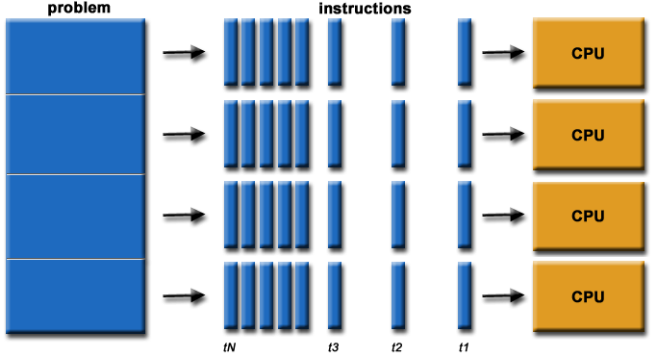
An Example

Slide 5
Why Use Parallel Computing?
Saves time
Solve larger problems
Cost savings
Provide concurrency

Slide 6
Types Of Parallelism
Data Parallelism
Task Parallelism

Slide 7
Flynn’s Classical Taxonomy
Distinguishes multi-processor architecture by instruction and data
SISD – Single Instruction, Single Data
SIMD – Single Instruction, Multiple Data
MISD – Multiple Instruction, Single Data
MIMD – Multiple Instruction, Multiple Data

Slide 8
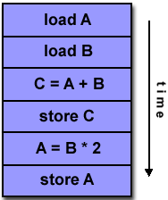
Flynn’s Classical Taxonomy: SISD
Serial
Only one instruction and data stream is acted on during any one clock cycle

Slide 9
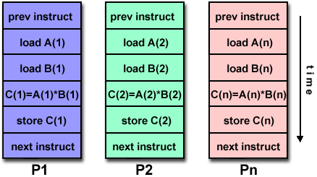
Flynn’s Classical Taxonomy: SIMD
All processing units execute the same instruction at any given clock cycle.
Each processing unit operates on a different data element.

Slide 10
MISD
Different instructions operated on a single data element.
Example: Multiple cryptography algorithms attempting to crack a single coded message.

Slide 11
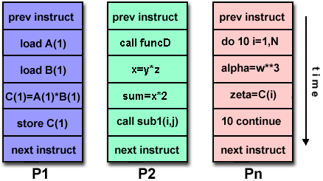
Flynn’s Classical Taxonomy: MIMD
Can execute different instructions on different data elements.
Most common type of parallel computer.

Slide 12
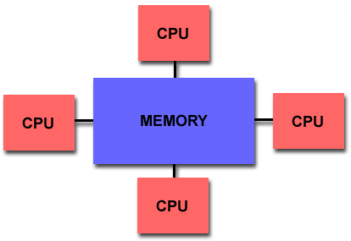
Parallel Computer Memory Architectures: Shared Memory Architecture
All processors access all memory as a single global address space.
Data sharing is fast.
Lack of scalability between memory and CPUs

Slide 13
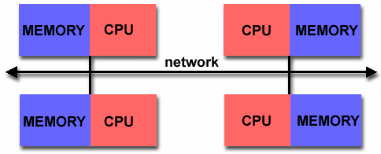
Parallel Computer Memory Architectures: Distributed Memory
Each processor has its own memory.
Is scalable, no overhead for cache coherency.
Programmer is responsible for many details of communication between processors.

Slide 14
Parallel Programming Models
Shared Memory Model
Messaging Passing Model
Data Parallel Model

Slide 15
Parallel Programming Models: Shared Memory Model
In the shared-memory programming model, tasks share a common address space, which they read and write asynchronously.
Locks may be used to control shared memory access.
Program development can be simplified since there is no need to explicitly specify communication between tasks.

Slide 16
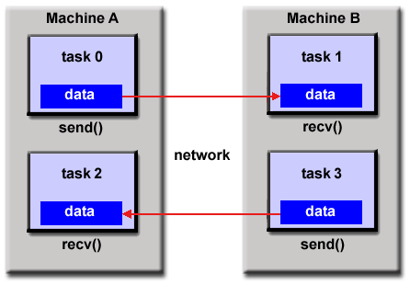
Parallel Programming Models: Message Passing Model

Slide 17
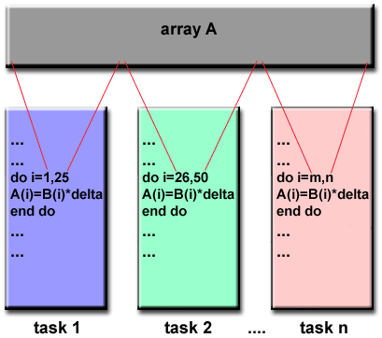
Parallel Programming Models: Data Parallel Model

Slide 18
Designing Parallel Programs
Partitioning
Domain Decomposition
Functional Decomposition
Communication
Synchronization

Slide 19
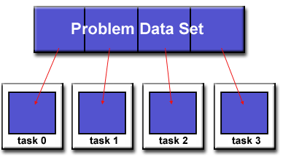
Partition : Domain Decomposition
Each task handles a portion of the data set.

Slide 20
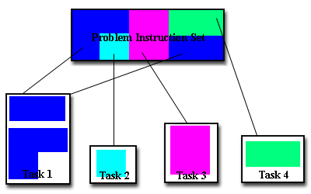
Partition Functional Decomposition
Each task performs a function of the overall work

Slide 21
Designing Parallel Programs Communication
Synchronous communications are often referred to as blocking communications since other work must wait until the communications have completed.
Asynchronous communications allow tasks to transfer data independently from one another.

Slide 22
Designing Parallel Programs Synchronization
Types of Synchronization:
Barrier
Each task performs its work until it reaches the barrier
When the last task reaches the barrier, all tasks are synchronized
Lock / semaphore
Typically used to protect access to global data or code section
Only one task at a time may use the lock
Synchronous communication operations
Notes:
When a task performs a communication operation, some form of coordination is required with the other task participating in the communication
For example, before a task can perform a send operation, it must first receive an acknowledgment from the receiving task that it is OK to send

Slide 23
Example:
As a simple example, if we are running code on a 2-processor system (CPUs "a" & "b") in a parallel environment and we wish to do tasks "A" and "B" , it is possible to tell CPU "a" to do task "A" and CPU "b" to do task 'B" simultaneously, thereby reducing the runtime of the execution.

Slide 24
Example: Array Processing
Serial Solution
Perform a function on a 2D array.
Single processor iterates through each element in the array
Possible Parallel Solution
Assign each processor a partition of the array.
Each process iterates through its own partition.

Slide 25
Conclusion
Parallel computing is fast.
There are many different approaches and models of parallel computing.

Slide 26
Problems to Consider
Data dependency
Load balancing

Slide 27
References
https://computing.llnl.gov/tutorials/parallel_comp
Introduction to Parallel Computing, www.llnl.gov/computing/tutorials/parallel_comp/#Whatis
www.cs.berkeley.edu/~yelick/cs267-sp04/lectures/01/lect01-intro
http://www-users.cs.umn.edu/~karypis/parbook/

